Slide 1
The Impact of COVID-19 on the Housing Industry in NYC
Daouda Gueye
Kwan Hung Fung

Slide 2
Home Value
What impact did COVID-19 have on New York City home values?

Slide 3
Visualization Techniques
Line Chart show the values through out the period
Visualize changes

Slide 4
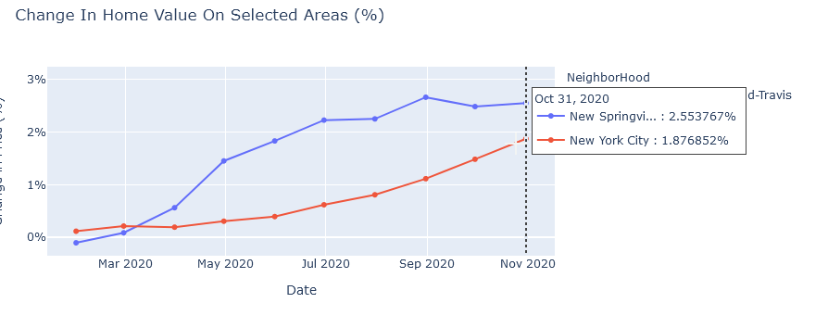
Line Chart

Slide 5
Home Value
Which areas has the largest increase on home value?
Which areas has the largest decrease on home value?

Slide 6
Visualization Techniques
Choropleth map to show which areas affected the most
Slider to go through the time from the beginning of the year through COVID period

Slide 7
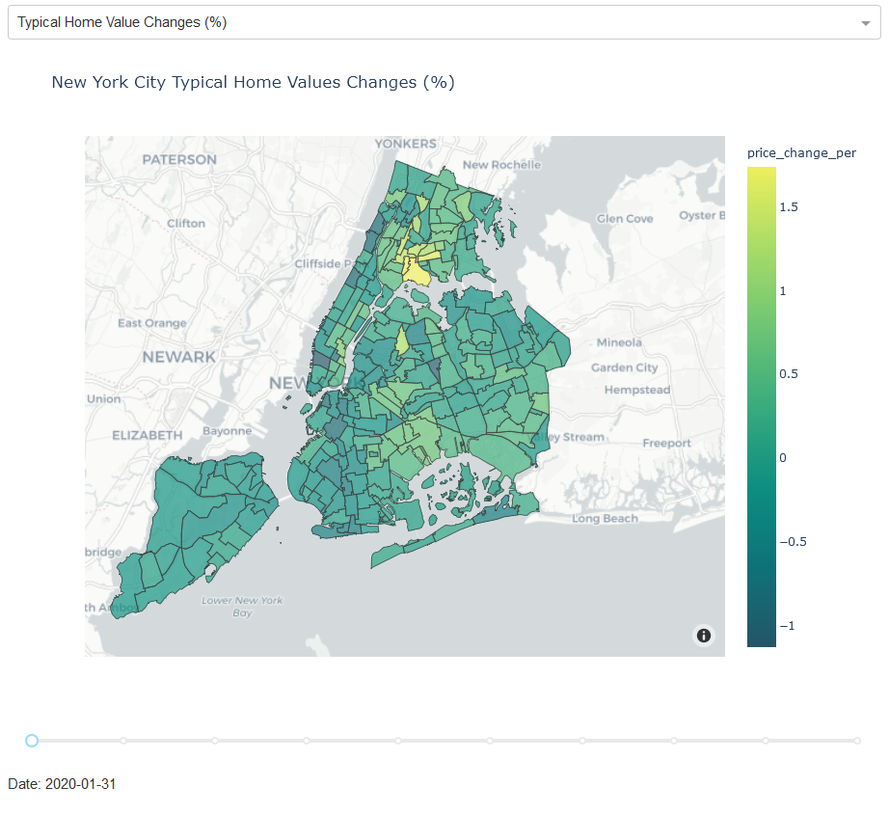
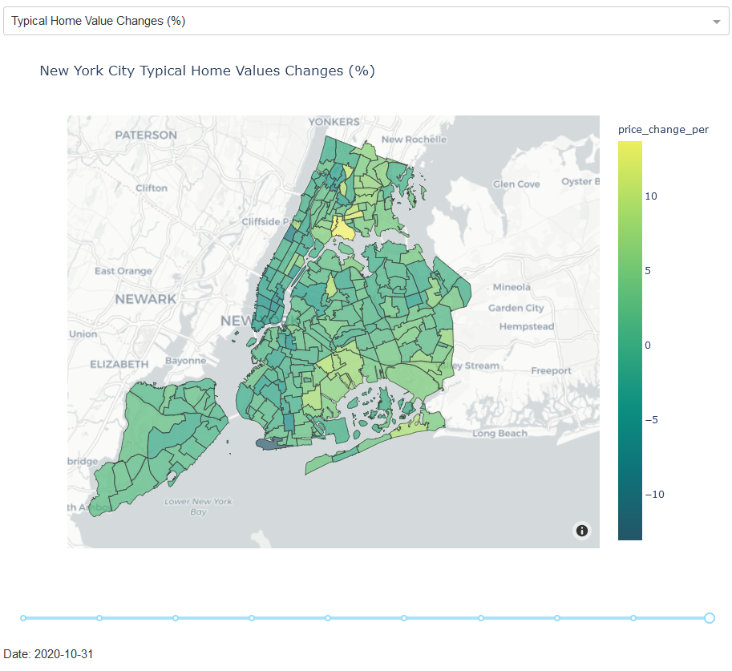
Choropleth map

Slide 8
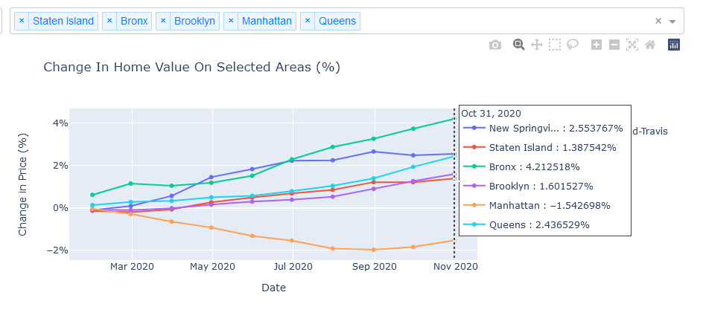
Home Value

Slide 9
Household Income
What is the correlation between change in home value and household income?

Slide 10
Visualization Techniques
Bubble Plot
Visualize how income correlates to the impacts of COVID

Slide 11
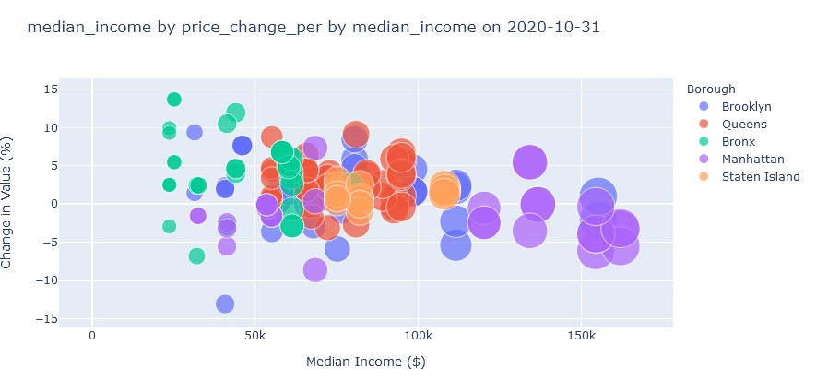
Bubble Plot

Slide 12
Datasets
Median Household Income
https://data.census.gov
Neighborhood Tabulation Areas (NTA)
https://data.cityofnewyork.us/City-Government/Neighborhood-Tabulation-Areas-NTA-/cpf4-rkhq
Zillow Home Value
https://www.zillow.com/research/data/

Slide 13
Demonstration and Observations
Python Dash Plotly
Hosted on local server
Github link
https://github.com/kfung9564/nyc_housing_visualization

